Slide 1

Design Patterns
SSE USTC Qing Ding
dingqing@ustc.edu.cn

Slide 2
Why Design Patterns
Many ways….
Learn from other’s experiences
Best practices
Best performance
Avoid pitfalls

Slide 3
Application Design
Many interactive Web applications are structured as brittle collections of interdependent Web pages. Such applications can be hard to maintain:
  When a page is moved, any links to the page must be updated.
  When a set of pages need to be password-protected, various configuration files need to be modified, or the pages themselves need to include new tags.
  When a page needs a new layout, the pages' tags must be rearranged.

Slide 4
Catalog of Enterprise Design Patterns
Presentation
  Intercepting Filter
  Front and Application Controller
Encapsulation of components
  Business Delegate
  Session Facade
Passing data across tiers
  Transfer Object (a.k.a. Value Object)
  Transfer Object Assembler
  Value List Handler
Access to data
  Data Access Object
  Composite Entity
Resolving dependencies
  Service Locator

Slide 5
Intercepting Filter
Context
Incoming requests need to be processed prior to handling
Requests require different processing
Problem
Controller require standardized requests
Requests and responses must be processed before and after handling
Forces
Centralized, yet modular method of pre- and post-processing is needed
De-coupling of processing and dispatching
Ease of extension

Slide 6
Intercepting Filter: solution
Solution
Use a Intercepting Filter to centralize pre- and post-processing of requests outside of the controller
Filters make a Responsibility Chain (GoF)

Slide 7
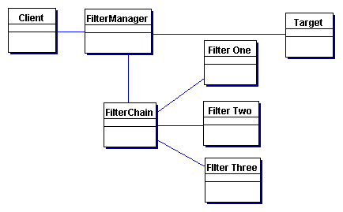
Intercepting Filter: structure

Slide 8
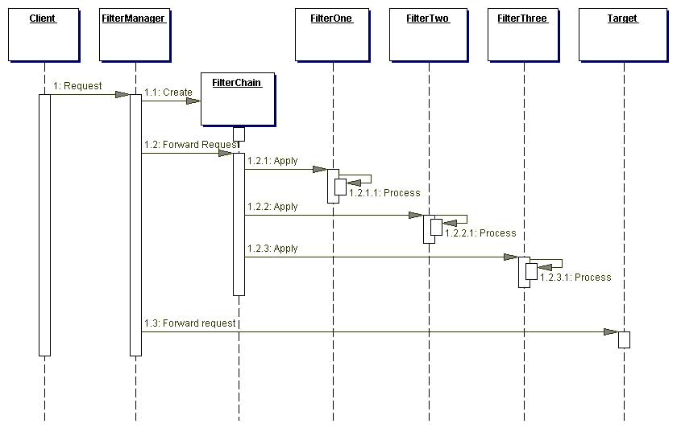
Intercepting Filter: interactions
Front and Application Controller

Slide 9
Front and Application Controller
Context
Application has mulitple reception points for handling requests
Control logic is scattered
Problem
A centralized access point for handling requests in the view layer is required
Lack of centralization leads to code duplication
Forces
Duplication of control logic
Sharing the logic by multiple requests
Separation of logic from presentation

Slide 10
Front and Application Controller: solution
Solution
Use a Front Controller to centralize processing of protocol-oriented requests.
Add Application Controller to manage requests in a protocol-independent manner

Slide 11
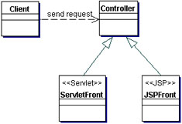
Front and Application Controller: structure

Slide 12
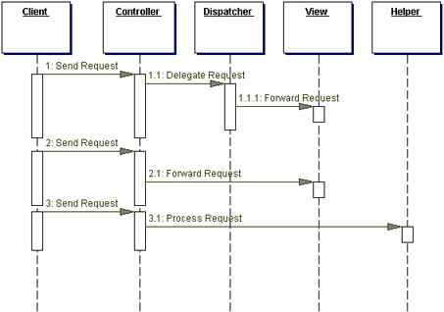
Front and Application Controller: interactions

Slide 13
The Front Controller
View 1
Client
Front
Controller
View 2
View 3
View 4
Helper
class
Helper
class
Helper
class

Slide 14
Front Controller
Funnel all client requests through a front controller
Centralize Functions
  view selection,
  security, and
  templating
Applies these functions consistently across all pages or views
When the behavior of these functions need to change, only a small area of the application needs to be changed:
  the controller and its helper classes.

Slide 15
Participants
FrontController (MainServlet)
  translates user requests and dispatches them as application events.
  selects Views for the user based on application state.
  applies templates and enforces security across all Views.
Views (e.g. editaccount.jsp, product.jsp, checkout.jsp)
  each View sends requests to the FrontController, whenever it would have otherwise communicated with another View.
The process
  A client sends a request (through a view) to the FrontController.
  The FrontController dispatches the request as an application event, and selects an appropriate view to be displayed on client.
  The FrontController may also apply a transformation or enforce a policy on the selected view.

Slide 16
Benefits of Front Controller
Navigation is easier to understand and configure.
  Because view selection is centralized in the front controller, you only have to look at the controller to understand the site navigation. Also, you only need to modify the controller in order to change the navigation.
Views are handled consistently.
  Since the front controller handles view selection, it can consistently apply templating and security policies across all views. Also, it is easier to configure the behaviors of these functions, since only the controller needs to be modified.
Views can be easily changed and reused.
  Since views communicate only with the front controller, there are no dependencies between views. This allows views, and even the front controller, to be varied and reused independently.

Slide 17
Consider
Complexity shifts to the front controller.
  The complexity of interaction between view components is traded for complexity in the front controller. Consequently, as an application grows, the controller can be harder to maintain.
Bypassing the front controller for access to areas with static content.
  The Front Controller pattern is applicable to sites with complex navigation through dynamic content. However, it is possible that such a site may also have areas containing largely static content; it would be overkill to service these areas with a front controller.
  The front controller should be configured not to handle requests for areas with static content. This can be accomplished by placing static content in a namespace that is not serviced by the front controller.
A front controller is typically implemented as a servlet
  Not a JSP page, because it is used for control, not presentation.

Slide 18
Mapping
Need to map all calls in a namespace to the controlling servlet
<web-app>
<!-- ... -->
<servlet>
<servlet-name>webTierEntryPoint</servlet-name>
<!-- ... -->
<servlet-class><!-- MainServlet --></servlet-class>
</servlet>
<servlet-mapping>
<servlet-name>webTierEntryPoint</servlet-name>
<url-pattern>/control/*</url-pattern>
</servlet-mapping>
<!-- ... -->
</web-app>

Slide 19
public void doGet(HttpServletRequest request, HttpServletResponse response) throws IOException, ServletException {
String selectedURL = request.getPathInfo(); // ... URLMapping
current = getURLMapping(selectedURL);
if ((current != null) && current.requiresSignin()) {
CustomerWebImpl customer = modelManager.getCustomerWebImpl();
if (customer.isLoggedIn()) {
doProcess(request);
}
else {
String signinScreen = getScreenFlowManager().getSigninScreen();
session.setAttribute(WebKeys.CurrentScreen, signinScreen);
session.setAttribute(WebKeys.SigninTargetURL, selectedURL);
}
}
else {
doProcess(request);
}
Locale locale = JSPUtil.getLocale(request.getSession());
getServletConfig().getServletContext()
.getRequestDispatcher(getScreenFlowManager().getTemplate(locale))
.forward(request, response);
}

Slide 20
After resolving any sign-in issues, the controller passes the request to the
RequestProcessor, which translates HTTP requests into application events:
public void processRequest(HttpServletRequest request) throws EStoreEventException
{
EStoreEvent event;
String selectedUrl = request.getPathInfo();
ModelManager mm;
ShoppingClientControllerWebImpl scc;
// ...
RequestHandler handler = getHandler(selectedUrl);
// ...
event = handler.processRequest(request);
// ...
Collection updatedModelList = scc.handleEvent(event);
mm.notifyListeners(updatedModelList);
// ...
}

Slide 21
Then, the ScreenFlowManager selects which page to present next
(using the information inside requestmappings.xml):
public void getNextScreen(HttpServletRequest request)
{
// ...
String selectedURL = request.getPathInfo();
String currentScreen;
URLMapping urlMapping = getURLMapping(selectedURL);
// ...
currentScreen = urlMapping.getScreen();
// ...
request.getSession().setAttribute(WebKeys.CurrentScreen, currentScreen);
}

Slide 22
Finally, the ScreenFlowManager applies a template to the requested page,
creating a screen. The template for the US-English locale is defined in template.jsp:
<html>
<head> <title> <j2ee:insert parameter="HtmlTitle" /> </title> </head>
<body bgcolor="white">
<j2ee:insert parameter="HtmlBanner" />
<j2ee:insert parameter="HtmlTopIndex" />
<table height="85%" width="100%" cellspacing="0" border="0">
<tr> <td valign="top"> <j2ee:insert parameter="HtmlBody" /> </td> </tr>
<tr> <td valign="bottom"> <j2ee:insert parameter="HtmlPetFooter" /> </td> </tr>
<tr> <td valign="bottom"> <j2ee:insert parameter="HtmlFooter" /> </td> </tr>
</table>
</body>
</html>

Slide 23
The values for the parameters HtmlBanner, HtmlTopIndex, etc. are defined for
all screens inside a single file, screendefinitions.xml:
<screen-definitions>
<template>/template.jsp</template>
<screen>
<screen-name>MAIN</screen-name>
<parameter key="HtmlTitle" value="Welcome to Java Pet Store Demo" direct="true"/>
<parameter key="HtmlBanner" value="/banner.jsp" direct="false"/>
<parameter key="HtmlBody" value="/index.jsp" direct="false"/>
<parameter key="HtmlPetFooter" value="/petfooter.jsp" direct="false"/>
<parameter key="HtmlFooter" value="/footer.jsp" direct="false"/>
</screen>
<!-- ... -->
<screen>
<screen-name>PRODUCT</screen-name>
<parameter key="HtmlTitle" value="Product Category" direct="true"/>
<parameter key="HtmlBanner" value="/banner.jsp" direct="false"/>
<parameter key="HtmlTopIndex" value="/topindex.jsp" direct="false"/>
<parameter key="HtmlBody" value="/product.jsp" direct="false"/>
<parameter key="HtmlFooter" value="/footer.jsp" direct="false"/>
</screen>
<!-- ... -->
</screen-definitions>

Slide 24
JSPView 1
Client
Front
Controller
JSPView 2
JSPView 3
JSPView 4
Helper
class
Helper
class
Java
Bean

Slide 25
Consider
Different types of application users need different sets of functions to support their workflows.
  shoppers need to be able to log in, browse the catalog, and make orders,
  administrator needs to be able to approve and deny orders, and check on inventory.
Consider an implementation where the objects working on behalf of these clients work directly with enterprise beans, coordinating these beans to carry out a workflow. This arrangement leads to the following problems:
  The client objects need to be aware of any associations or required interactions among the beans. However, nothing prevents the clients from using these beans inappropriately.
  If the beans' APIs are modified, the client objects must be modified accordingly. This change can be hard to manage.
  Even if a set of enterprise beans associated by workflow reside on the same server, a client object still has to make remote calls to each of the beans. This results in a lot of network traffic.

Slide 26
Business Delegate
Context
A multi-tiered, distributed system requires remote method invocations to send and receive data across tiers
Clients are exposed to the complexity of dealing with distributed components.
Problem
Presentation-tier components interact directly with business services, exposing the underlying implementation details
Presentation-tier components that use the business service API produce excessive network traffic (with no client-side caching mechanism or aggregating service)
Client is forced to deal with the networking issues of EJB
Forces
Presentation-tier clients need access to business services.
Business services APIs may change as business requirements evolve.
It is desirable to reduce network traffic between client and business services.

Slide 27
Business Delegate: solution
Solution
Use a Business Delegate (a POJO) to reduce coupling between presentation-tier clients and business services.
The Business Delegate hides the underlying implementation details of the business service, such as lookup and access details of the EJB architecture.
The Business Delegate acts as a client-side business abstraction; it provides an abstraction for, and thus hides, the implementation of the business services.

Slide 28
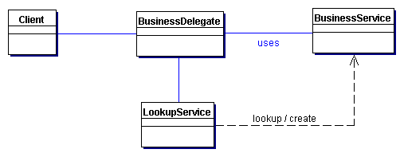
Business Delegate: structure
The client requests the BusinessDelegate to provide access to the underlying business service.
The BusinessDelegate uses a LookupService to locate the required BusinessService component.

Slide 29
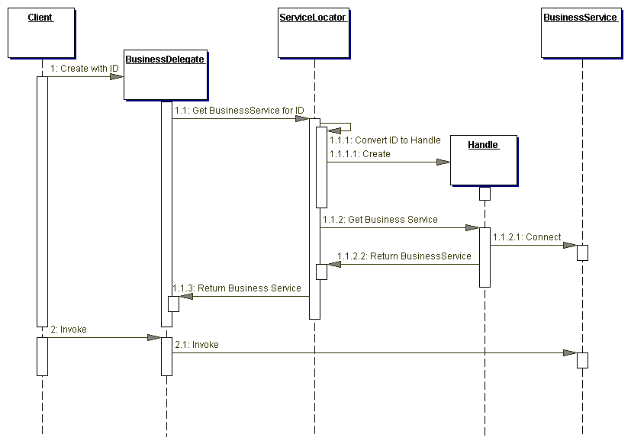
Business Delegate: interactions

Slide 30
Business Delegate: participants
Business Delegate
  provides control and protection for the business service
  shields the client from the underlying implementation details of BusinessService naming and lookup
  initialized without an ID, BD requests the service from the Lookup Service, which returns the Service Factory, such as EJBHome
  initialized with an ID string, the BusinessDelegate uses the ID string to reconnect to the BusinessService.
Service Locator
  encapsulates the implementation details of JNDI lookup
BusinessService
  a business-tier component (EJB) that provides the required service to the client.

Slide 31
Session Facade
Context
EJB encapsulate business logic and business data and expose their interfaces (their complexity of the distributed services) to the client tier
Problem
Tight coupling, which leads to direct dependence between clients and business objects
Too many method invocations between client and server, leading to network performance problems;
Lack of a uniform client access strategy, exposing business objects to misuse
Forces
Provide a simpler interface to the clients and reduce inter-tier coupling
Reduce the number of business objects that are exposed to the client
Hide from the client the underlying interactions and interdependencies between business components
Provide a uniform coarse-grained service layer to separate business object implementation from business service abstraction.

Slide 32
Session Facade: solution
Solution
Use a session bean as a facade to encapsulate the complexity of interactions between the business objects participating in a workflow.
The Session Facade manages the business objects, and provides a uniform coarse-grained service access layer to clients.

Slide 33
Benefits
More consistent use of enterprise beans.
  Business objects are less likely to be misused, since interactions between them are handled only by the session facade.
Easier support for multiple client types.
  A JSP page/servlet front-end, a JFC/Swing front-end, and a web service can access an enterprise data model through the same facade.
A place to centralize logging, transaction handling, and security.
  A session facade is a convenient and logical place to implement these functions, since this is the single point of entry for clients.
Reduced network traffic.
  Instead of making multiple remote calls to coordinate enterprise beans, client objects make one remote call to the session facade, which takes care of the coordination.
Greater flexibility with the enterprise data model.
  It's easier to assess the impact of changing the enterprise data model if all interactions with the model are centralized in a facade or set of facades.
Greater flexibility with the server implementation.
  A session facade can use enterprise beans, the JDBC API, CORBA, or other technologies to provide application functionality to its clients. Since the implementation details of the server are hidden from the client, application services can be implemented or modified without client redeployment.

Slide 34
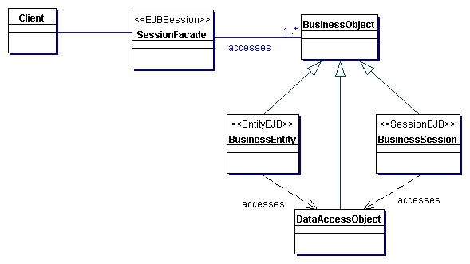
Session Facade: structure
The client requests the SessionFacade to perform an action on its behalf.
The SessionFacade uses components perform the steps constituting the action.

Slide 35
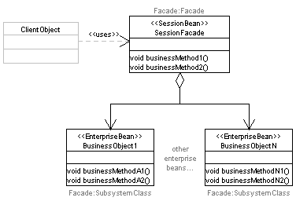

Slide 36
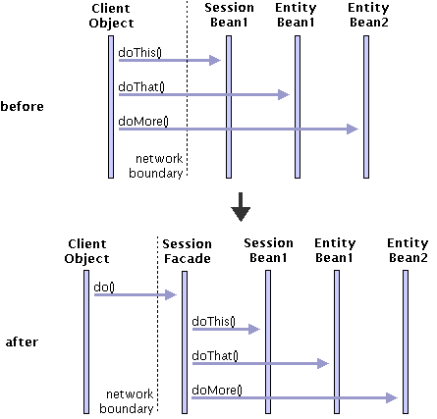
Session Facade: interactions

Slide 37
Session Facade: participants
Client
  represents the client of the SessionFacade, which needs access to the business service; can be another session bean (SessionFacade) in the same business tier or a BusinessDelegate in another tier
Session Facade
  manages the relationships between numerous BusinessObjects and provides a higher level abstraction to the client
  offers coarse-grained access to the participating BusinessObject
BusinessObject
  provides data and/or some service

Slide 38
Session Facade: consequences
Introduces a business tier controller
Exposes uniform interface for clients
at the same time, a single method call returns a greater amount of data to the client than the individual accessor methods each returned
Reduces coupling between clients and application
  small number of highly abstract remote interfaces
Reduces network traffic
  reduces remote calls from clients to EJBs
Provides coarse-grained, use-case-focused access
  facade per session bean vs. system-wide facade
Centralizes common use-case's policies (security, transactions)

Slide 39
Implementation
Session Bean
  Use a stateful session bean to represent a client-specific, short-lived workflow. Stateful session beans are designed to maintain conversational state on behalf of a client. This state may include data read from databases or information entered by the user during the workflow, and lasts only as long as the client's session.
  Use a stateless session bean to provides generic services. When a facade does not need to maintain any client-specific state information, the same instance should be reusable by other clients.

Slide 40
Transfer Object (a.k.a. Value Object)
Context
Application clients need to exchange data with enterprise beans, combining data coming from different services
Problem
Every call to an EJB is potentially remote, regardless of the proximity of the client to the bean
Using multiple calls to get methods that return single attribute values is inefficient for obtaining data values from an enterprise bean
Forces
Typically, applications have a greater frequency of read transactions than update transactions. The client requires the data from the business tier for presentation, display, and other read-only types of processing
The client usually requires values for more than one attribute or dependent object from an enterprise bean. Thus, the client may invoke multiple remote calls to obtain the required data
The number of calls made by the client to the enterprise bean impacts network performance

Slide 41
Transfer Object: solution
Solution
Use a TransferObject (a POJO) to encapsulate the business data and transport then from an EJB to the client
A single method call is used to send and retrieve the TransferObject
When the client requests the enterprise bean for the business data, the enterprise bean can construct the Transfer Object, populate it with its attribute values, and pass it by value to the client

Slide 42
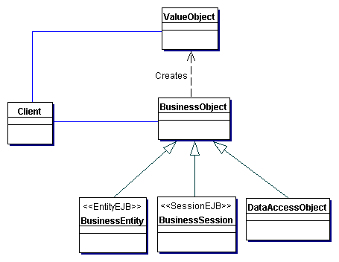
Transfer Object: structure

Slide 43
Value Object
package ejava.persistence.dao;
public OwnerValue implements Serializable {
String name_;
String taxId_;
public OwnerValue(String name, String taxId) {
name_ = name;
taxId_ = taxId;
}
public OwnerValue(OwnerValue rhs) { this(rhs.name_, rhs.taxId_); }
public String getName() { return name_; }
public void setName(String name) { name_ = name; }
public String getTaxId() { return taxId_; }
public void setTaxId(String taxId) { taxId_ = taxId; }
public String toString() {
return "name="+name + ", taxId="+taxId_;
}
}

Slide 44
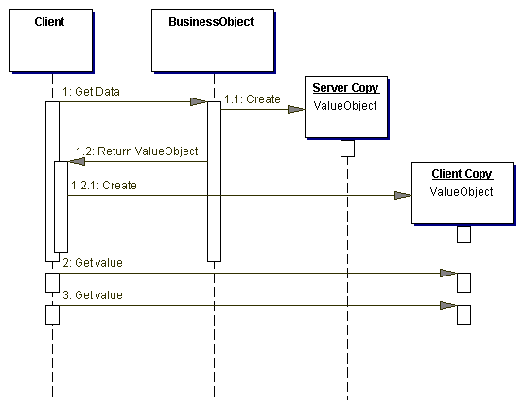
Transfer Object: interactions

Slide 45
Transfer Object: participants
Client
  represents the client of the enterprise bean; the client can be an end-user application, a Business Delegate or another BusinessObject
BusinessObject
  represents a role in this pattern that can be fulfilled by a session bean, an entity bean, or a Data Access Object (DAO)
  is responsible for creating the TransferObject and returning it to the client upon request
  may also receive data from the client in the form of a Transfer Object and use that data to perform an update.
TransferObject
  is an arbitrary serializable Java object
  different protection strategies: all members public or immutability

Slide 46
Transfer Object: consequences
Simplifies entity bean and remote interface
single method producing a TransferObject instead of a bunch of single-attribute-returning methods
Transfers more data in fewer remote calls
at the same time, a single method call returns a greater amount of data to the client than the individual accessor methods each returned
Reduces network traffic
May introduce stale Transfer Objects
updatable Transfer Objects may result in inconsistent EJB state

Slide 47
Transfer Object Assembler
Context
Application clients frequently need to access data that is composed from multiple objects (session EJB, entity EJB, DAOs etc.)
Problem
There is a tight coupling between the client and the distributed components spread over multiple tiers
Client needs to have the necessary business logic to construct the model, which affects complexity and performance overhead.
problem of code duplication for model access, which occurs when an application has many types of clients
Forces
Access to one of distributed components is associated with a network overhead.
Client typically needs only to obtain the model to present it to the user.
Clients do not need to be aware of the intricacies and dependencies in the model implementation. It is desirable to have loose coupling between the clients and the business components.

Slide 48
Transfer Object Assembler: solution
Solution
Use a Transfer Object Assembler to build the required model or submodel. The Transfer Object Assembler uses Transfer Objects to retrieve data from various business objects and other objects that define the model or part of the model.
The Transfer Object Assember constructs a composite Transfer Object that represents data from different business components. The Transfer Object carries the data for the model to the client in a single method call. Since the model data can be complex, it is recommended that this Transfer Object be immutable.

Slide 49
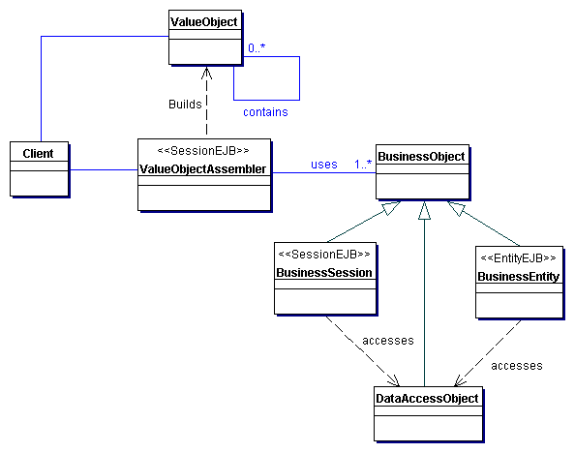
Transfer Object Assembler: structure

Slide 50
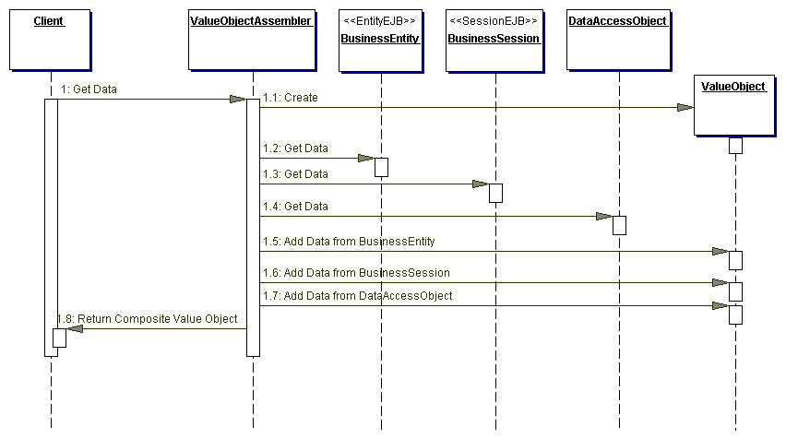
Transfer Object Assembler: interactions

Slide 51
Transfer Object Assembler: participants
TransferObjectAssembler
  constructs a new TransferObject on the client’s side
  locates the required BusinessObject instances to build the composite Transfer Object
Client
  typically a SessionFacade or a BusinessDelegate
TransferObject
  a composite TransferObject that represents complex data from various components that define the application model
BusinessObject
  provides the required data to the TransferObjectAssembler
  usually implemented as a session bean, an entity bean, a DAO, or a regular Java object

Slide 52
Transfer Object Assembler: consequences
Separates bussiness logic from client logic
TransferObjectAssembler contains bussiness logic related to objects composition and creates data model required by the client, which then does need to handle that
Reduces coupling between clients and application model
TransferObjectAssembler hides from the client the complexity, thus reducing its dependency on the application model
Improves network performance
reduces remote calls to the bussiness tier
client resources are not engaged in TOA creation process
May introduce stale data
TOA creates a snapshot of application state, which may become stale and cannot be updated then

Slide 53
Value List Handler
Context
The client requires a list of items from the service for presentation.
The number of items in the list is unknown and can be quite large in many instances.
Problem
Getting lists of objects via ejbFindXXX() calls are network expensive
Container is obliged to return a collection of entire objects
Forces
client needs an efficient query facility to avoid having to call the entity bean's ejbFind() method and invoking each remote object returned.
A server-tier caching mechanism is needed to serve clients that cannot receive and process the entire results set
EJB finder methods are not suitable for browsing entire tables in the database or for searching large result sets from a table.
EJB finder methods are not suitable for caching results
Client wants to scroll forward and backward within a result set.

Slide 54
Value List Handler: solution
Solution
Use a ValueListHandler to control the search, cache the results, and provide the results to the client in a result set whose size and traversal order meets the client's requirements.
ValueListHandler directly accesses a DAO that can execute the required query.
ValueListHandler stores the results obtained from the DAO as a collection of Transfer Objects.
The ValueListHandler implements an Iterator pattern to provide the solution.

Slide 55
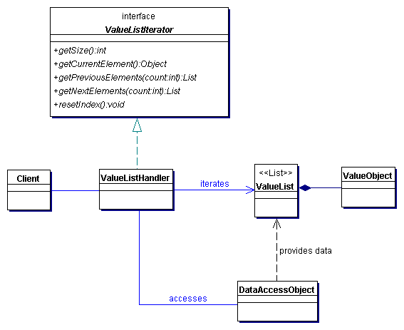
Value List Handler: structure

Slide 56
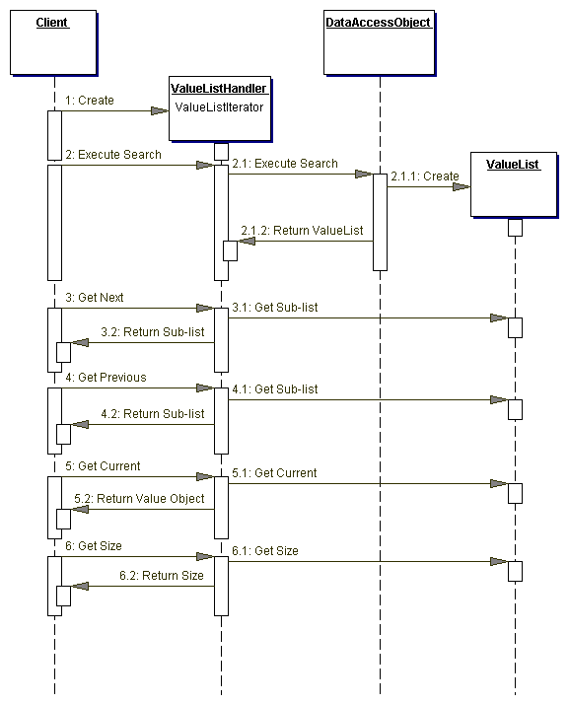
Value List Handler: interactions

Slide 57
Value List Handler: participants
ValueListIterator
  may provide iteration facility with methods getSize(), getCurrentElement(), getPrevElements(int off),
  getNextElements(int off), resetIndex()
ValueListHandler
  implements the ValueListIterator interface
  executes the required query, obtains the query results and manages it in a privately held collection represented by the ValueList object.
  upon request, obtains the Transfer Objects from the cached ValueList, creates a new collection of Transfer Objects, serializes the collection, and sends it back to the client
  tracks the current index and size of the list
ValueList
  a list that holds the results of the query stored as Transfer Objects

Slide 58
Value List Handler: consequences
Provides alternative to EJB finders for large queries
  the objects are composed into a single entity
Caching query results on server side
More flexible querying
Improves network performance
  data is transmitted as needed, in small chunks
Allows deferring the entity-bean transactions
  loading and storing multi-level composites may introduce considerable complexity

Slide 59
Enterprise Patterns
Access to data

Slide 60
Data Access Object
Context
Access to data varies depending on the source of the data (the type of the storage and vendor)
Problem
Code that depends on specific features of data resources ties together business logic with data access logic, which makes it difficult to replace or modify an application's data resources.
Forces
Components need to retrieve and store information from persistent stores and other data sources like legacy systems, B2B, LDAP etc.
Components typically use proprietary APIs to access external and/or legacy systems to retrieve and store data.
Components need to be transparent to the actual persistent store or data source implementation to provide easy migration to different vendor products, different storage types, and different data source types.

Slide 61
Data Access Object: solution
Solution
Use a Data Access Object (DAO) to abstract and encapsulate all access to the data source. The DAO manages the connection with the data source to obtain and store data.
The business component that relies on the DAO uses the simpler interface exposed by the DAO for its clients. DAO acts as an adapter between the component and the data source.

Slide 62
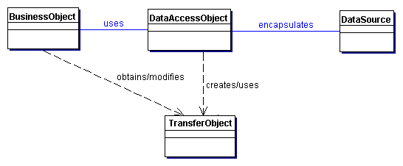
Data Access Object: structure

Slide 63
Data Access Object
package ejava.persistence.dao;
public class OwnerDAO {
OwnerValue values_;
public void insert(Connection connection, OwnerValue values) {
Statement statement = null;
try {
statement = connection.createStatement();
int rows = statement.executeUpdate(
"insert into owner (name, taxid) values (" + values.getName() +
", " + values.getTaxId() + ")");
if (rows != 1) ...
}
finally {
if (statement != null) statement.close();
}
}
}

Slide 64
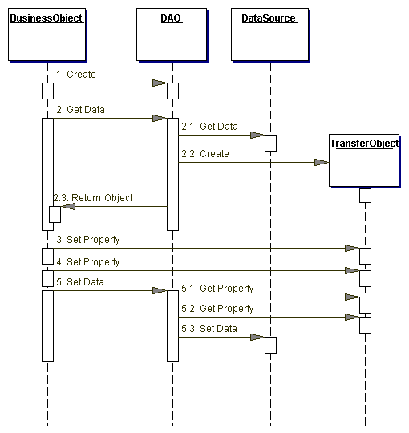
Data Access Object: interactions

Slide 65
Data Access Object: participants
BusinessObject
  represents the data client that requires access to the data source to obtain and store data; may be implemented as a session bean, entity bean, or some other Java object
DataAccessObject
  abstracts the underlying data access implementation for the BusinessObject to enable transparent access to the data source
DataSource
  represents a data source implementation (RDBMS, OODBMS, XML repository, flat file system, another system, service, LDAP etc.)
TransferObject
  a data carrier used for returning data to the client or to DataAccessObject

Slide 66
Data Access Object: consequences
Encapsulates the data-access details and data schemas
Enables transparency and migration
  BusinessObject is shielded from the data source implementation
Reduces code complexity in Business Objects and clients
Centralizes all data access into a separate layer
Not useful for pure CMP-based applications
  container performs the DAO's duties for CMP EJBs

Slide 67
Composite Entity
Context
Entity beans are not intended to represent every persistent object in the object model
Entity beans are better suited for coarse-grained persistent business objects
Problem
Entity beans represent distributed coarse-grained persistent business objects
Direct mapping of the object model to an Enterprise JavaBeans (EJB) model results in multiple small beans
Forces
Entity beans are best implemented as coarse-grained objects due to the high overhead associated with each entity bean
It is desirable to keep the entity beans coarse-grained and reduce the number of entity beans in the application.
Direct mapping of object model to EJB model results in complex inter-bean references that must be maintained
Excessive inter-entity bean communication often leads to a performance bottleneck

Slide 68
Composite Entity: solution
Solution
Use Composite Entity to model, represent, and manage a set of interrelated persistent objects rather than representing them as individual fine-grained entity beans.
A Composite Entity bean represents a tree of objects, with a coarse-grained bean as a root and dependent objects as branches or leaves

Slide 69
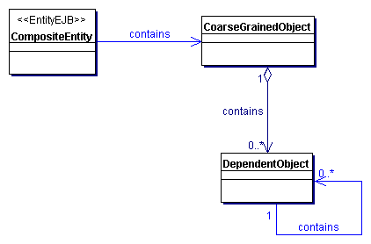
Composite Entity: structure

Slide 70
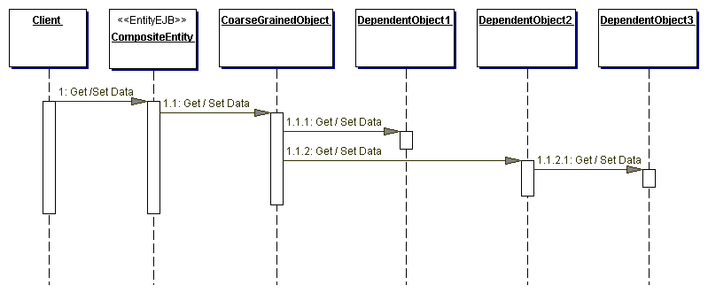
Composite Entity: interactions

Slide 71
Composite Entity: participants
CompositeEntity
  may be the coarse-grained object, or it may hold a reference to the coarse-grained object
Coarse-grained Object
  an object that has its own life cycle and manages its own relationships to other objects
  can be a Java object contained in the Composite Entity, or the Composite Entity itself can be the coarse-grained object that holds dependent objects
DependentObjects
  an object that depends on the coarse-grained object and has its life cycle managed by the coarse-grained object
  can contain other dependent objects; thus there may be a tree of objects within the Composite Entity

Slide 72
Composite Entity: consequences
Eliminates inter-bean communication
  the objects are composed into a single entity
Reduces database schema dependency
Increases object granularity
Facilitates composite Transfer Object creation
  composite entities produce composite (larger) Transfer Objects
Overhead related to the tree management
  loading and storing multi-level composites may introduce considerable complexity

Slide 73
Enterprise Patterns
Resolving dependencies

Slide 74
Service Locator
Context
Clients want to find and access components and business-tier services
There exists a service register
JDNI lookups are costly and add complexity to clients
Problem
JNDI-related lookups are vendor-dependent
Forces
EJB/JMS clients need to use the JNDI API to look up EJBHome/JMS components.
Context factory for the initial JNDI is vendor-dependent
Context for JMS is different from the context for EJB
Lookup and creation of service components could be complex and may be used repeatedly in multiple clients in the application.
EJB clients may need to reestablish connection to a previously accessed enterprise bean instance, having only its Handle object.

Slide 75
Service Locator: solution
Solution
Service Locator object abstracts JNDI usage and to hide the complexities of initial context creation, EJB home object lookup, and EJB object re-creation.
Multiple clients can reuse the Service Locator object to reduce code complexity, provide a single point of control, and improve performance by providing a caching facility.

Slide 76
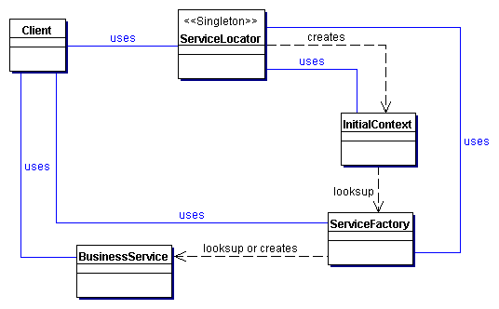
Service Locator: structure

Slide 77
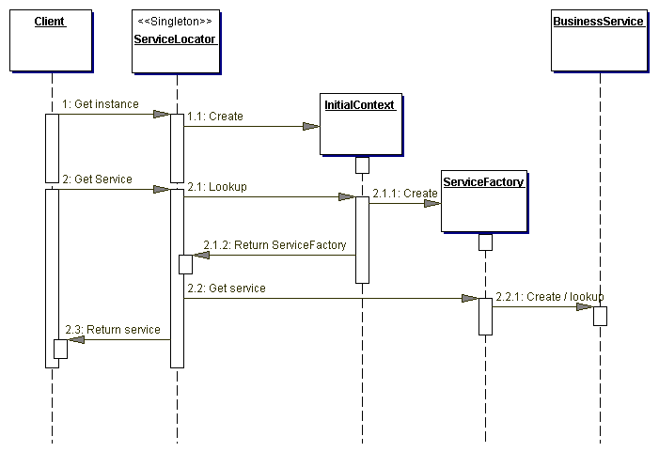
Service Locator: interactions

Slide 78
Service Locator: participants
Client
  wants to lookup and access a component or a business-related service
ServiceLocator
  provides a simple, uniform interface for service lookup and creation
  encapsulates the service lookup interface and the dependency on vendor-specific InitialContext
Cache
  optional caching mechanism, which stores references to the previously found services
InitialContext
  starting point for lookup and creation process
  depends on the vendor and the service to look-up

Slide 79
Service Locator: participants (cont.)
Target
  the target service to be looked-up (EJB, DataSource, ConnectionFactory, MailSession etc.)
RegistryService
  stores references to services or components available to the client look-ups
  JNDI, UDDI, eBXML

Slide 80
Service Locator: consequences
Abstract complexity and uniform service access to clients
  encapsulated complexity of lookup and creation process and keeps it hidden from the client
Improved network performance
  clients are not involved in JNDI lookup and factory/home object creation.
  ServiceLocator can aggregate the network calls required to look up and create business objects.
Improved client performance
  initial context objects and references to the factory objects (EJBHome, JMS connection factories) are cached

Slide 81
Fast-Lane Data Reading
Sometimes it is more important to be fast than it is to be up to date.
Accessing the DB through EJB can be slow

Slide 82
Accelerate reading by
returning a value object from Entity Beans
  Eliminates RMI calls for each method
  Get all variable values in a single RMI call
bypassing EJB and using a DAO instead.
  Eliminates RMI calls for each row of DB
  Get whole table in a single call

Slide 83
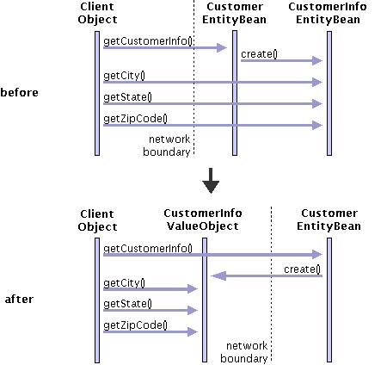

Slide 84
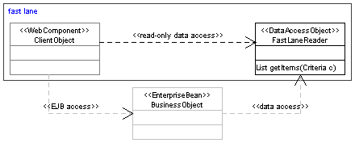
Return Structure
Session
Bean
Entity
Bean
RMI
Client
Servlet
DB
Fast lane
Data
Access
Object
JDBC

Slide 85
Consider
Nontransactional reads are inappropriate for data that change often.
  Nontransactional reads are often used to build input to subsequent transactions. This works properly when catalog information changes infrequently.
  If the catalog data changes frequently, placing orders is more likely to fail, because the catalog items on which the orders depend cannot be found reliably.
Consider using page-by-page iterator for long data lists. It can break up the data into manageable pieces that the user or application can manage.

Slide 86
Large Remote List Access
Often need to access a large list
Presenting the entire list is often
  unnecessary (the user isn't interested in all the items)
  impossible (there isn't enough space for all the items).
These problems can be avoided by using a page-by-page iterator

Slide 87
Web Application Design
Data
  What data is available?
  How do we store it or how is it stored in the DB?
    Schema
    Data types
    Etc.
  Where is the data?

Slide 88
Web Application Design
Define Use cases
  What are the use cases?
  What services are provided for each use case?
Define generic and specific services
  Accomplish tasks of use cases
Define flow through use cases
  Not pages, just flow of operations
This stage may force changes in data

Slide 89

Web Application Design
Organize flow through use cases into pages
  Be sensible, follow good examples
Remember front controller design
  Access to pages should flow through front controller
  Front controller should
    Determine use
    Do any necessary filtering
    Use java beans to pass necessary arguments to view

Slide 90
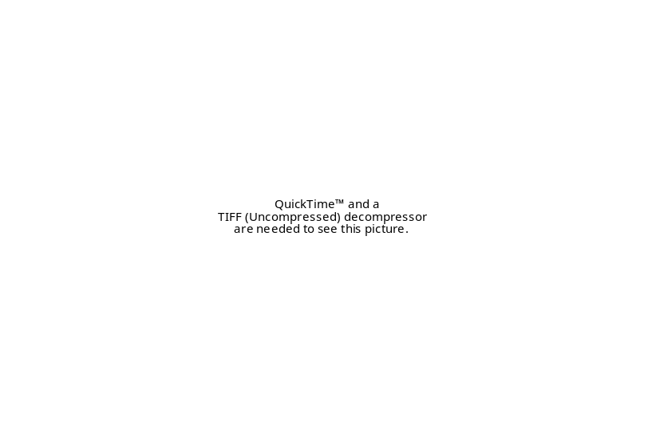
Web Application Design
Look and feel
  Define a consistent look and feel
  Banners, contents, etc.
All views (JSPs)
  Based on one view
  Include appropriate elements
    Using info from front controller
  Custom tags abstract details

Slide 91
Web Application Design
Design EJBs
  Entity beans -- defined by database
  Session beans
    Session Façade
    Business Methods
Design Custom Tags
  Interact with controller via java beans
  Interact with model via session EJBs

Slide 92
Object/RDBMS
How do we map the following Class Model to an RDBMS
Owner
Account
name_ : String
owner_
id_ : String
taxId_ : String
1
*
balance_ : double
InterestBearingAccount
CheckingAccount
rate_ : double
checkFee_ double
termDays_ : int
minimumBalance_ : double

Slide 93
Storing the Objects as Blobs
void save() throws SQLException, Exception {
PreparedStatement pstatement = null;
try {
pstatement = connection_.prepareStatement("insert into accounts(id, data) values (?, ?)");
for(int i=0; i<accounts_.length; i++) {
pstatement.setString(1,accounts_[i].getId());
try {
File file = File.createTempFile("tmp","dat");
ObjectOutputStream ostream = new ObjectOutputStream(new FileOutputStream(file));
ostream.writeObject(accounts_[i]);
ostream.close();
FileInputStream istream = new FileInputStream(file);
pstatement.setBinaryStream(2, istream, (int)file.length());
//pstatement.setObject(2,accounts_[i]);
pstatement.execute();
pstatement.clearParameters();
}
}
finally { if (pstatement != null) pstatement.close(); }
}

Slide 94
Restoring Objects from Blobs
void restore() throws SQLException, Exception {
Statement statement = null;
ResultSet rs = null;
try {
statement = connection_.createStatement();
rs = statement.executeQuery("select id, data from accounts";);
Vector accounts = new Vector();
while (rs.next()) {
String accountNo = rs.getString(1);
ObjectInputStream istream = new ObjectInputStream(rs.getBinaryStream(2));
Account account = (Account) istream.readObject();
//Account account = (Account) rs.getObject(2);
accounts.add(account);
accounts_ = new Account[accounts.size()]; accounts.toArray(accounts_);
}
finally {
if (rs != null) rs.close(); if (statement != null) statement.close();
}
}

Slide 95
Blobs
Pros
  Good encapsulation of object properties
Cons
  Slows database performance
  Can’t search based on object properties
  A bit of a pain
Rather than using Blobs, what about mapping the object to tables in the Database?

Slide 96
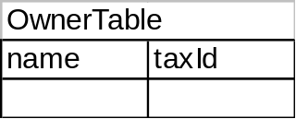
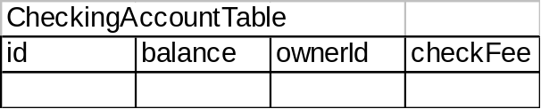
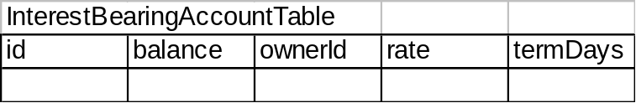
Horizontal Partitioning
Each concrete class is mapped to a table
Owner
Account
name_ : String
owner_
id_ : String
taxId_ : String
1
*
balance_ : double
InterestBearingAccount
CheckingAccount
rate_ : double
checkFee_ double
termDays_ : int
minimumBalance_ : double

Slide 97
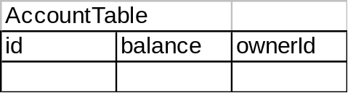
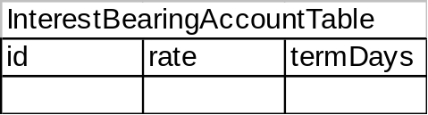
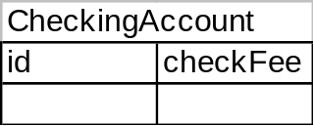
Vertical Partitioning
Each class is mapped to a table
Owner
Account
name_ : String
owner_
id_ : String
taxId_ : String
1
*
balance_ : double
InterestBearingAccount
CheckingAccount
rate_ : double
checkFee_ double
termDays_ : int
minimumBalance_ : double

Slide 98
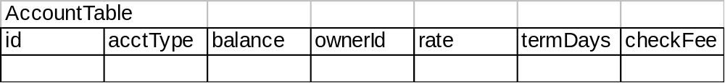
Unification
Each sub-class is mapped to the same table
Owner
Account
name_ : String
owner_
id_ : String
taxId_ : String
1
*
balance_ : double
InterestBearingAccount
CheckingAccount
rate_ : double
checkFee_ double
termDays_ : int
minimumBalance_ : double

Slide 99
RDBMS Mapping
Horizontal Partitioning
  entire object within one table
  only one table required to activate object
  no unnecessary fields in the table
  must search over multiple tables for common properties
Vertical Partitioning
  object spread across different tables
  must join several tables to activate object
Vertical Partitioning (cont.)
  no unnecessary fields in each table
  only need to search over parent tables for common properties
Unification
  entire object within one table
  only one table required to activate object
  unnecessary fields in the table
  all sub-types will be located in a search of the common table

Slide 100
Inserting Data Access Objects
Application
Object
Data Access
Object
Value
Object
Account
AccountDAO
Account
Value
Owner
Value
Owner
OwnerDAO

Slide 101
Summary
EJB provide a mere technology which may be misused
Improvements in EJB specification fixes some flaws, while introduces some others
EJB design patterns provide solutions to common problems related to EJB technology
Enterprise design patterns comprise entire applications: from presentation, through bussiness, ending up with data access

Slide 102

Readings
Alur D., Crupi J., Malks D., Core J2EE. Wzorce projektowe. Wydanie II. Helion, 2004
Core J2EE Patterns, http://java.sun.com/blueprints/
/corej2eepatterns/
http://www.corej2eepatterns.com/
/Patterns2ndEd/index.htm
http://www.theserverside.com/

Slide 103
Q & A
?

